Slide 1


Artificial Intelligence as a Catalyst for Halal Food Supply Chain Transformation
Bridging tradition with innovation to ensure authenticity, transparency, and trust in global Halal food systems
Prof. Dr. Asif Ahmad
Director Institute of Food and Nutritional Sciences,
PMAS-Arid Agriculture University Rawalpindi
Pakistan
World Halal Summit 2025 | 26-29 November | Türkiye

Slide 2

The Halal Food Market: A Growing Global Opportunity
The global Halal food market represents one of the fastest-growing segments in the food industry, valued at over $2 trillion annually. With 2.05 billion Muslims worldwide and increasing demand from non-Muslim consumers seeking ethical and clean food options, the market continues to expand at an unprecedented rate.
This growth brings both opportunities and challenges. As supply chains become more complex and global, ensuring authenticity and compliance with Islamic dietary laws becomes increasingly difficult. Traditional monitoring methods struggle to keep pace with the scale and complexity of modern food systems.

Slide 3

The Growing Importance of Halal Food Supply Chains
Despite being home to the world's second-largest Muslim population, Pakistan is now developing standardized halal certification, harmonizing Halal Standards with SMIIC, and developing robust supply chain integrity using AI concepts
Halal food has evolved beyond mere religious compliance; it now represents a global benchmark for quality, safety, and ethical production, appealing to both Muslim and non-Muslim consumers.

Slide 4

The Challenge: Complex Supply Chains, High Stakes
Modern Halal food supply chains involve intricate networks spanning multiple countries, hundreds of suppliers, processors, distributors, and retailers. Each node represents a potential point of non-compliance or contamination.
Traditional certification methods rely heavily on periodic audits, paper documentation, and manual verification processes. These approaches are time-consuming, expensive, and vulnerable to human error or fraudulent practices. With global trade volumes increasing, the limitations of conventional monitoring become increasingly apparent, creating risks for consumers and businesses alike.

Slide 5


Moving Towards Solution
Enter Artificial Intelligence
AI technologies offer unprecedented capabilities to transform Halal food supply chains, addressing long-standing challenges while creating new opportunities for efficiency, transparency, and trust.

Slide 6





AI Technologies Transforming Halal Supply Chains
Machine Learning
Blockchain Integration
Algorithms that analyze patterns, detect anomalies, predict risks, and continuously improve from data to identify potential compliance issues before they occur
Immutable distributed ledgers create transparent, tamper-proof records of every transaction and movement throughout the supply chain
Computer Vision
Predictive Analytics
Visual recognition systems monitor production facilities, verify product authenticity, and ensure proper handling procedures in real-time
Advanced forecasting models optimize inventory, predict demand fluctuations, and prevent waste while maintaining compliance
Process Automation
IoT Integration
Intelligent systems handle routine certification tasks, documentation, and compliance checks with speed and accuracy
Connected sensors continuously monitor conditions, track products, and provide real-time data feeds for AI analysis

Slide 7

The Road Ahead: Vision for a Smart Halal Supply Chain in Pakistan
AI Integration
Blockchain Traceability
Real-time Compliance
IoT Monitoring
Our vision is a fully integrated ecosystem of AI, blockchain, and IoT, ensuring halal integrity, sustainability, and unparalleled consumer trust.
This includes real-time halal compliance dashboards accessible to all stakeholders and enhanced export competitiveness through internationally recognized digital certification.

Slide 8
The Impact on Certification Bodies
Traditional Approach
AI-Enhanced Approach
Periodic on-site audits (quarterly or annually)
Continuous real-time monitoring and verification
Manual document review and verification
Automated document processing and validation
Limited sampling and spot checks
Comprehensive data analysis across all operations
Reactive response to consumer complaints
Proactive risk detection and prevention
High costs per certification
Reduced costs through automation efficiency
Weeks or months for initial certification
Days for initial certification with ongoing validation

Slide 9
Real-Time Monitoring: From Farm to Fork
Farm/Source
1
IoT sensors monitor animal welfare, feed composition, and environmental conditions
2
Processing
Computer vision validates procedures, AI tracks ingredient sourcing and handling
Storage
3
Environmental sensors ensure proper temperature, humidity, and separation from non-Halal products
4
Distribution
GPS tracking and blockchain logging verify secure, compliant transportation
Retail
5
Point-of-sale systems verify authenticity, consumers access full product history via smartphone
This end-to-end visibility creates unprecedented transparency, allowing immediate detection and response to any compliance issue at any point in the supply chain.

Slide 10
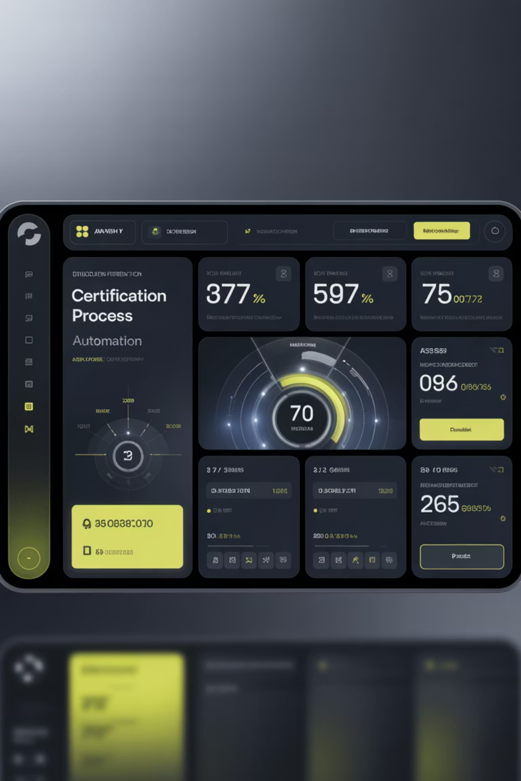
Automating Certification: Efficiency Meets Accuracy
AI dramatically streamlines the certification process, reducing time and costs while improving accuracy and consistency. Intelligent systems can process applications, verify documentation, conduct preliminary assessments, and flag potential issues for human review.
1
Intelligent Document Processing
AI extracts and validates information from certificates, invoices, and compliance documents across multiple languages and formats
2
Automated Risk Assessment
Machine learning models evaluate suppliers and facilities, prioritizing high-risk entities for detailed human audit
3
Continuous Compliance Monitoring
Systems track changes in supplier status, ingredient sources, and regulatory requirements, triggering alerts when re-certification is needed

Slide 11
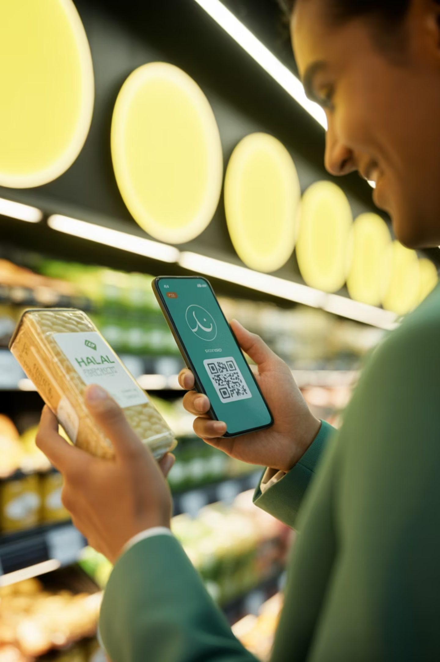
Building Consumer Trust Through Transparency
Today's consumers demand transparency and authenticity. AI-powered systems enable unprecedented visibility into product origins and supply chain practices, accessible instantly via smartphone.
Scan Product
Consumer scans QR code on packaging
View Journey
Complete supply chain history displayed with timestamps and locations
Verify Certificates
All relevant Halal certifications and audit reports accessible
Confirm Authenticity
Blockchain verification confirms product legitimacy

Slide 12

Global Market Competitiveness
Market Access Advantages
Operational Excellence
Risk Mitigation
Early detection of supply chain disruptions
Streamlined compliance with diverse international standards
Real-time adaptation to market demand fluctuations
Proactive compliance management reduces penalties
Reduced time-to-market for new products
Faster entry into new markets with automated certification
Brand protection through fraud prevention
Improved supplier negotiations with data insights
Enhanced reputation with technology-forward positioning
Crisis management with complete traceability
Scalability without proportional cost increases
Competitive advantage in quality-conscious markets

Slide 13
Regulatory Compliance: Meeting Diverse Standards
Different countries and certification bodies maintain varying Halal standards, creating complexity for international operators. AI systems can simultaneously monitor and ensure compliance with multiple regulatory frameworks.
JAKIM (Malaysia)
Gulf Standards
Automated compliance with Malaysia's comprehensive Halal standards and documentation requirements
Adherence to GCC Halal requirements with real-time verification and reporting
Indonesian Standards
International Bodies
Integration with BPJPH certification systems and local regulatory frameworks
Compatibility with SMIIC, OIC, and other global Halal certification organizations

Slide 14
Implementation Roadmap
Phase 1: Assessment
Phase 3: Expansion
Evaluate current systems, identify pain points, and define objectives. Conduct stakeholder analysis and ROI projections.
Scale successful pilot to broader operations. Train staff, integrate with existing systems, expand supplier network.
Duration: 2-3 months
Duration: 6-12 months
Phase 2: Pilot Program
Phase 4: Optimization
Implement AI solutions in limited scope—single product line or facility. Test, refine, and document results.
Refine algorithms, enhance automation, integrate advanced analytics. Continuous improvement cycle begins.
Duration: 4-6 months
Duration: Ongoing

Slide 15
Overcoming Implementation Challenges
Technology Infrastructure
Many stakeholders lack robust IT systems. Solution: Cloud-based platforms with minimal local requirements and mobile-first design for accessibility
Digital Literacy
Varying levels of technical expertise across supply chain. Solution: Intuitive interfaces, comprehensive training programs,
and multilingual support
Data Privacy Concerns
Sensitive business information shared across networks. Solution: Encryption, permissioned blockchain, and clear data governance frameworks
Integration Complexity
Connecting diverse legacy systems and stakeholders. Solution: API-based architecture, standardized data formats, phased integration
approach
Cost Barriers
Initial investment concerns for smaller operators. Solution: Subscription models, cooperative platforms, government incentives, and demonstrable ROI

Slide 16

The Role of Policymakers
Government support and regulatory frameworks are crucial for widespread AI adoption in Halal supply chains. Policymakers can accelerate transformation through strategic initiatives.
Standardization Initiatives
Develop unified data standards and interoperability requirements for AI systems across certification bodies
Financial Incentives
Tax credits, grants, or subsidized loans for businesses implementing AI-enabled compliance systems
Education & Training
Fund programs to develop workforce skills in AI, blockchain, and digital supply chain management
Research & Development
Support innovation through public-private partnerships and dedicated research funding for Halal tech solutions
Infrastructure Development
Invest in digital infrastructure, particularly in rural areas where food production originates

Slide 17
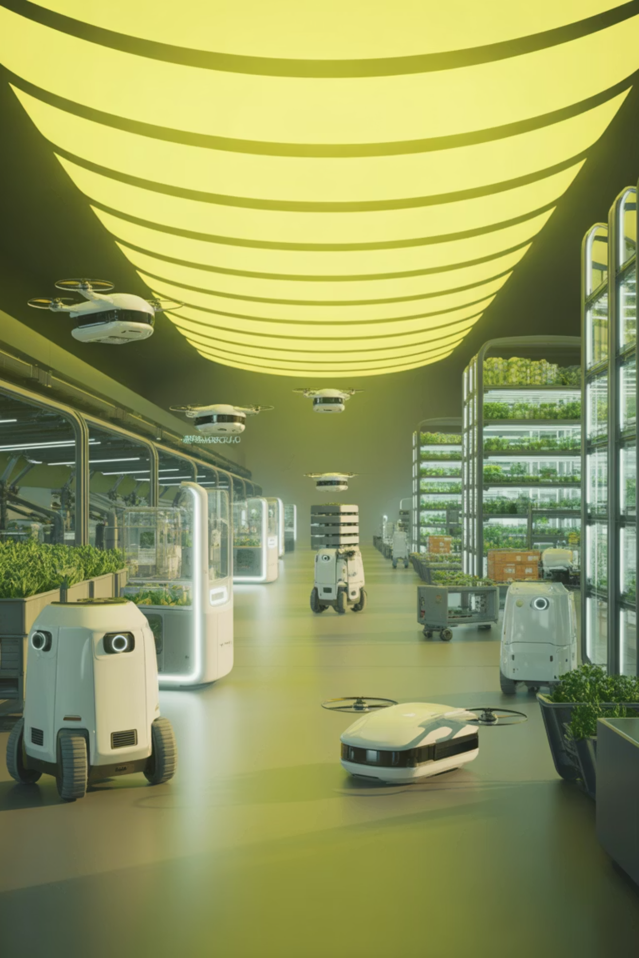
Future Horizons: What's Next?
Advanced Biometric Authentication
DNA testing and molecular analysis integrated with AI for absolute product verification at the cellular level
Quantum Computing
Exponentially faster processing for complex supply chain optimization across millions of variables simultaneously
Autonomous Compliance
Self-executing smart contracts that automatically enforce Halal standards without human intervention
Predictive Quality Control
AI systems that predict product quality issues before they occur based on environmental and processing data

Slide 18
Call to Action: Embrace the Transformation
For Supply Chain Executives
For Certification Bodies
Begin assessment of AI implementation opportunities within your operations. Partner with technology providers to pilot programs in high-impact areas.
Explore AI-enhanced audit processes and blockchain integration. Collaborate on industry-wide standards for technology adoption.
For Technology Providers
For Policymakers
Develop Halal-specific solutions addressing unique compliance requirements. Engage with industry stakeholders to understand needs.
Create supportive regulatory frameworks and incentive programs. Invest in digital infrastructure and workforce development initiatives.
For Investors
For Consumers
Recognize the enormous opportunity in Halal supply chain technology. Support innovative startups addressing this $2 trillion market.
Demand transparency and traceability from Halal brands. Support companies investing in verification technology with your purchasing decisions.

Slide 19

The Future is Now
Artificial Intelligence is not a distant possibility for Halal food supply chains—it is an available, proven, and increasingly essential tool for ensuring authenticity, efficiency, and trust in an expanding global market.
The organizations that embrace AI-driven transformation today will lead the Halal food industry tomorrow. They will command consumer trust, achieve operational excellence, access new markets, and set standards that others follow.
The convergence of technology and tradition offers unprecedented opportunity to strengthen Halal practices while building sustainable, efficient, and transparent food systems that serve diverse consumers worldwide.
The transformation begins now. The question is not whether to adopt AI, but how quickly you can implement it.

Slide 20

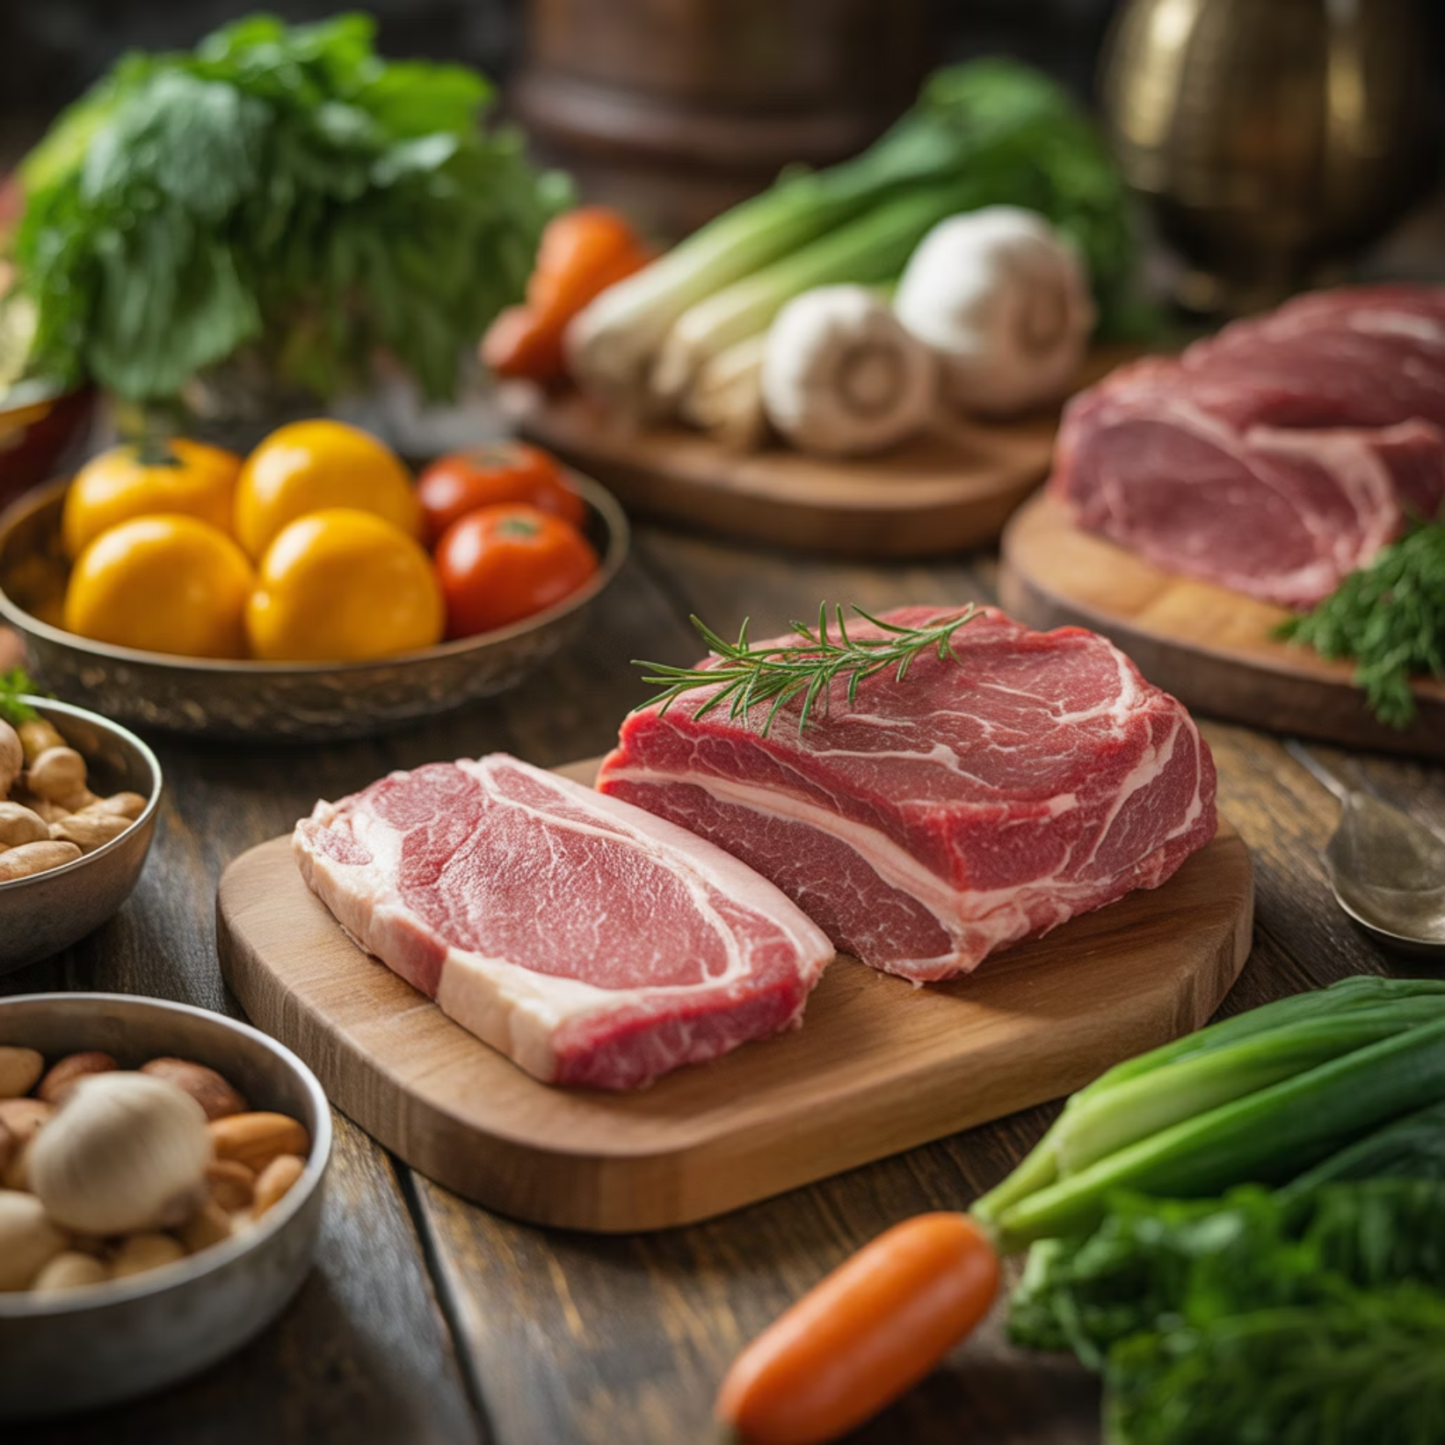
THANKS
Prof. Dr. Asif Ahmad,
Director, Institute of Food and Nutritional Sciences, PMAS-Arid Agriculture University Rawalpindi, Pakistan
Email: asifahmad@uaar.edu.pk
Website: Home | foodtechnologist

